Slide 1


Ask Us Anything Session
Learn more about INPACE
Dr Svetlana Klessova
Project coordinator
G.A.C. Group (France)
25 September 2026
©INPACE 2024-2027

Slide 2
Agenda
INPACE Presentation (30 minutes)
  About INPACE: Mission, key figures, and goals
  The INPACE Hub
  Thematic Working Groups (TWGs) and Clusters
  INPACE Peer Advisory Network
  INPACE Virtual fair
  Opportunities for collaboration with INPACE
  India-EU Digital Cooperation Conference 2026
  INPACE Final Event in May 2027
  Pilot projects
Q&A session (30 minutes)

Slide 3
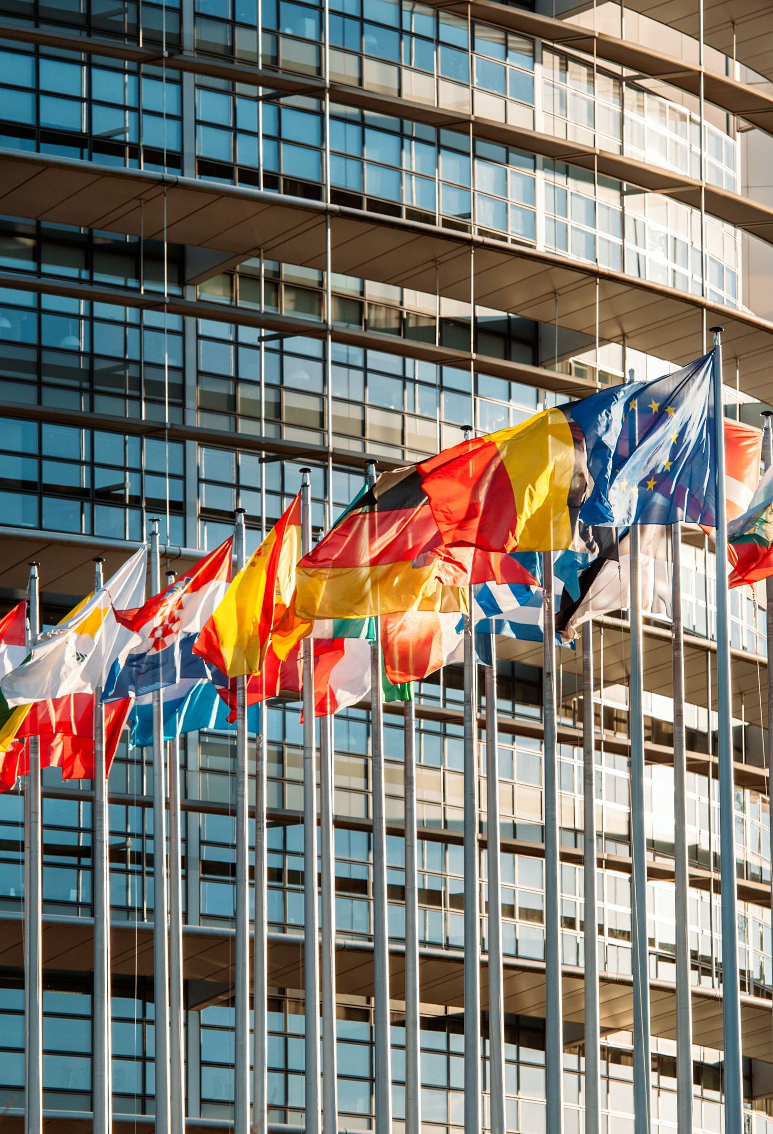
Context
Why is INPACE important?
1
2
3
The EU aims to strengthen its connection to the Indo-Pacific region for research, innovation, technology deployment, regulation alignment, and supply chain stability.
Promotion of digital technologies being one of the highest priorities, the EU has established Digital Partnerships with Japan (2022), the Republic of Korea (2022) and Singapore (2023), and a Trade and Technology Council (2022) with India.
The goal is that society and businesses in both regions benefit from opportunities in the growing global digital economy.
©INPACE 2024-2027

Slide 4

INPACE: key figures
Coordination and Support Action
January 2024 - June 2027 (3,5 years)
21 consortium partners
13 Asian and European countries
Funding: Horizon Europe and Swiss State Secretariat for Education, Research, and Innovation SERI

Slide 5

Mission
What is INPACE aiming to achieve?
The mission of INPACE is to support digital partnerships and the Trade and Technology Council and to contribute to the deepening of the collaboration between Europe and India, Japan, the Republic of Korea and Singapore in the domain of digital technologies and their application for the well-being of the citizens in Europe and in the Indo-Pacific region.
New International Digital Strategy for the EU
https://digital-strategy.ec.europa.eu/en/library/joint-communication-international-digital-strategy-eu
©INPACE 2024-2027

Slide 6


Join the INPACE Hub:
Your gateway to Europe-Indo-Pacific digital collaboration
The INPACE Hub is an innovative digital platform that brings together technology and policy specialists with validated resources, collaboration opportunities, and expert connections.
Join the Hub to:
Create synergies with your own projects and initiatives – propose joint activities, promote your technologies, and more
Tap into expert networks spanning multiple regions
Access validated resources/knowledge hub, and funding opportunities
Foster impactful digital initiatives with your involvement, including at core roles!
Advance trusted digital technologies for sustainable well-being
Discover the INPACE Hub and register:
https://egcp.enrich-global.eu/communities/inpace
©INPACE 2024-2027

Slide 7
Hub Services and Value
Services/factures | Description | Benefit
Expert connection, inc. dedicated groups (free*) | Directory searchable by country, topic and organisation | Quick access to relevant partners, speakers, experts…
Shared workspace (free*) | Secure repository with online co-editing – collaborative tool | One common, updated version
Event management and analytics (free*) | Tools to publish news, announce and manage events incl. registrations and analytics | Greater visibility Easy management of the events “Exit questionnaires”
Communication (free*) | Real-time document co-creation and workspaces for groups | Regular engagement within communities
Knowledge repository and (free*) | Long-term access to documents and results of your projects | Preservation and reuse after the project ends
Matchmaking (free*) | Search by expertise and interest | Support for new joint initiatives
Virtual fair (paid) | 3D virtual expo | Showcase your products and technologies temporary or permanent link for your usage
*Free in DIY (do it yourself) mode.
©INPACE 2024-2027

Slide 8
Thematic Working Groups & Clusters
5G and beyond
Internet of trust and security
Smart continuum
1
Standardisation
Policy dialogues
Joint programming
Digital education and skills
5
Digital dialogues, policies and education
Digital technologies - future networks
INPACE HUB Knowledge platform and Community Platform.
Innovation and entrepreneurship for sustainable well-being
Public administrations, infrastructures and services
Digitalisation of industry and supply networks
Enabling technologies - chips for the future
2
Advanced computing
Advanced functionalities
Ground-breaking technologies
4
Digital technologies - trustworthy decision support
Trusted AI
Data technologies
High performance computing
3
©INPACE 2024-2027
8

Slide 9
Peer advisory network: a trusted network of senior European and Indo-Pacific peers, launch in the INPACE project, continue post-project under ENRICH GLOBAL association (INPACE partner)
WHAT THE NETWORK WILL OFFER
A CLEAR SCOPE
Peers of comparable experience
Coordinators, senior researchers and industry experts with proven experience, e.g. in EU projects.
Doors beyond one’s own field
Senior peers know their topic well; the network opens trusted contacts in other sectors and countries.
A concrete question, a short exchange
A few minutes of orientation, a referral or the right introduction, on topics the peer chooses.
Projects through trusted channels
Consortia, partners and testbeds reached through peers who have done it before.
WHO IT IS FOR
Project coordinators · Senior researchers & RTOs · Companies & SMEs · Standards & policy experts
IN SCOPE:
PEER ADVISORY
HANDLED BY OTHER MECHANISMS
Trusted partner search among experienced peers
Access to consortia and projects in other sectors and countries
Orientation on standards, regulation and market entry
Senior-to-senior exchange across Europe and the Indo-Pacific
Coaching of young or inexperienced actors (NCPs etc): they also could be involved through their supervisors and senior experienced specialiists
Horizon Europe training and “how it works” questions (NCPs)
Reviews of proposals or concepts
Specialised expert support (separate service)
CORE PROPOSITION
Peers exchange with peers of comparable experience around a concrete question. Support for newcomers matters too, but it needs its own mechanism, separate from the peer advisory network.
©INPACE 2024-2027

Slide 10
Discussion session in Seoul, South Korea
Feedback from European and Korean stakeholders, Seoul, 15 September 2026
WHAT WE HEARD
WHAT IS NEEDED: TWO LEVELS
Interest in peer exchange is real, but time and trust are the binding constraints.
Level 1: the peer advisory network
Experienced peers only, opening doors to other sectors and countries. This is the INPACE target.
Level 2: a separate community
Nurturing young or inexperienced actors, through NCPs, projects or collective Q&A sessions. This shall be set up by NCPs and implemented with the national or other funding
Complementary to NCPs
Complementarity to be agreed, to avoid duplication.
Korea first, then wider
Japan, India and Singapore as possible next steps, always with senior peers. Focus could be different (market access for Singapore, NCP support for Japan…)
Time is scarce
Experienced coordinators have no capacity for repeated, generic questions.
Trust comes first
Collaboration starts with people you know, or with a visible track record.
Peers want peers
Senior actors want to exchange with peers of comparable experience.
Active, not passive
Members must engage; moderation turns membership into collaboration.
THE AGREED APPROACH
Confirmed the interest in reciprocal exchange between experienced peers.
©INPACE 2024-2027

Slide 11
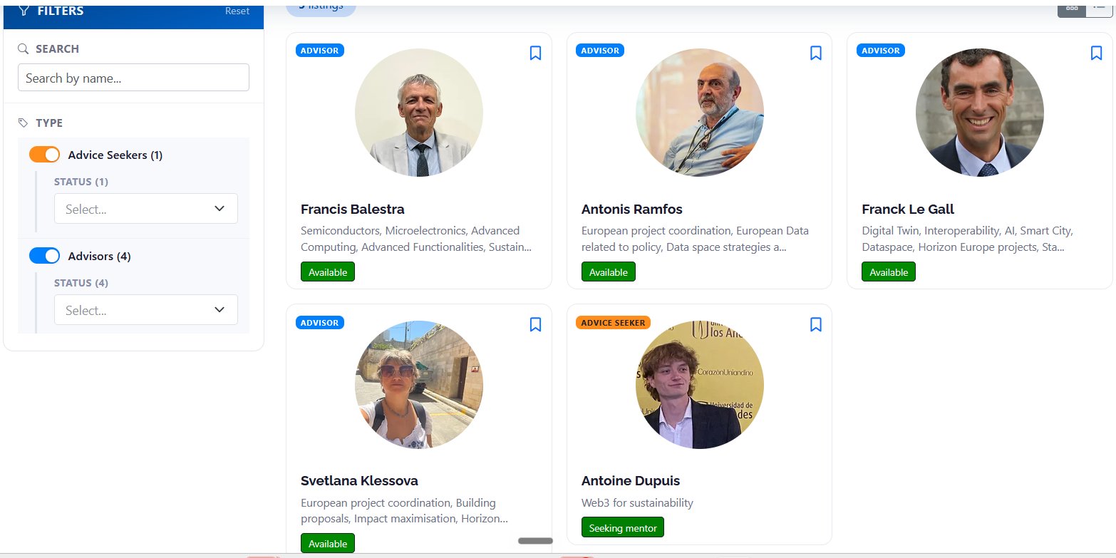
The advisory network marketplace (post project)
Matchmaking tool: peer advisory network
Offer-and-seek profiles, curated matching and mutual opt-in on one platform
Register
Offer + seek profile
Curated matching
Mutual opt-in
Exchange
Record next step
Young people: own mechanism needed, outside INPACE

Slide 12
How: trust made visible, time protected
1
VISIBLE TRACK RECORD
2
SUPPORTED SENIORS
3
ACTIVE COMMUNITY
EU PROJECT EXPERIENCE
Self-declared: one star per EU project, a big star for each coordination
EXPERTISE
Seld-declared: Keywords per topic: semiconductors, standards, data spaces, 6G…
TRUSTED REFERRALS
Recommendation by a known peer
Seoul: “To partner, we need peers with 3+ stars, meaning with 3 projects . Then this is a basis for my trust »
TIME IS PROTECTED
Senior peers stay visible, with their stars
A younger team member handles requests and follow-up – this is decided by each peer
INPACE & EG curate: only suitable requests reach the peer, who accepts, declines or defers
MODERATED GROWTH
Existing members get to know each other first
Seniors bring in newcomers who intend to engage
A small concrete step builds trust faster than open networking
YOUR VIEW
Ideas and suggestions are welcome: how would you use such a network, for which directions? Any interest?

Slide 13
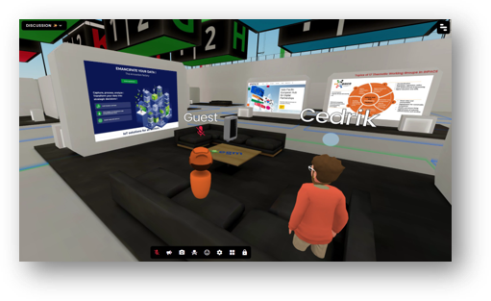
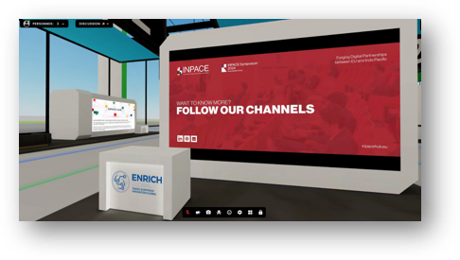
Virtual fairs
INPACE Virtual Fair is designed to connect mature European and Indo-Pacific innovations (technologies and products) through an immersive 3D environment.
Key focus areas:
Trustworthy AI
Semiconductors & advanced chip technologies
Secure IoT & infrastructure protection
Digital identities & trust systems
6G networks & communication infrastructure
What participants receive:
Professional 3D virtual booth on INPACE virtual expo center
Marketing and PR support
Six months of exposure with all costs covered by European funding

Slide 14
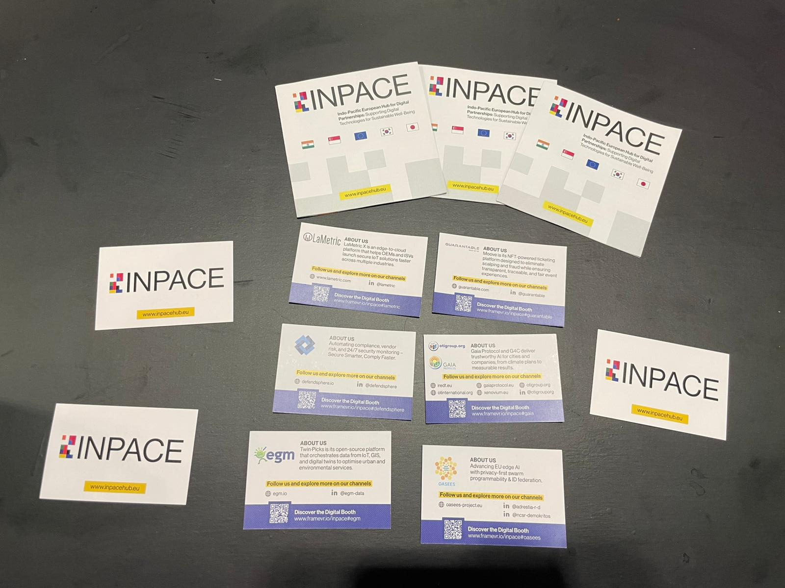


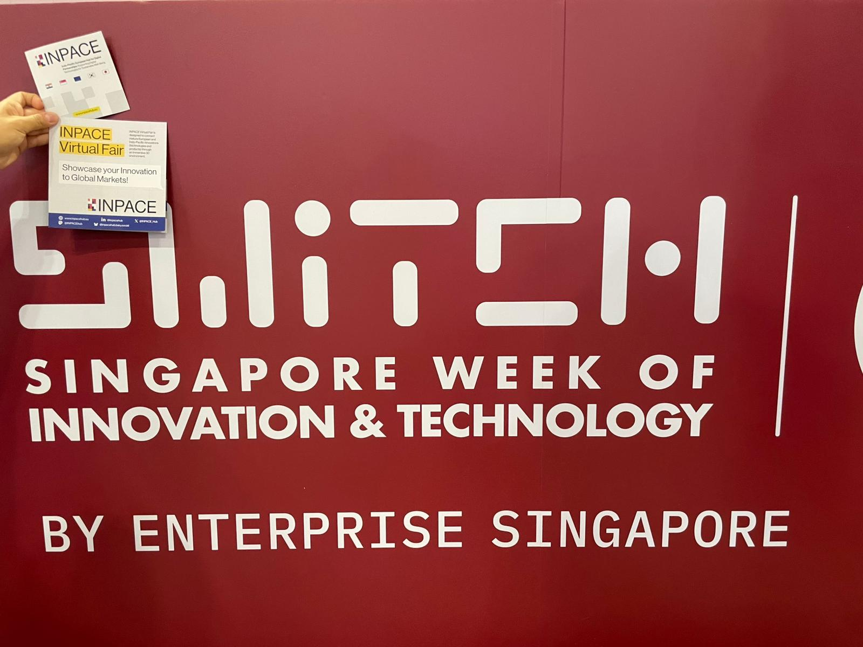





1st Virtual Fair Successfully Delivered!
The 1st INPACE Virtual Fair was launched in testing mode in July 2025, with 7 companies which were accepted for participation.
Communication Support: the companies were promoted during the EU-Indo-Pacific Digital Partnership Conference 2025 (Singapore) and SWITCH Singapore
150+ visits in the 1st edition of the Virtual Fair
Feedback from a participant: “Everything looks great. It’s really interesting to explore the exhibition, and I appreciate that you included our project in this initiative”

Slide 15



2nd Virtual Fair Highlights
The 2nd edition of the INPACE Virtual Fair was launched in July 2026, with more companies accepted for participation, including the new stands developed following the EU-Japan Hackathon on Interoperability of Dataspaces and Digital Public Infrastructure held in Tokyo, Japan, in March 2026.
The 3D virtual booth has been developed to connect showcased innovations with global audiences, policymakers, industry leaders, innovation ecosystem players, and organisations interested in digital cooperation.
Virtual Fair Participants:
Aralia, Taiwan: A Sustainable Data Ecosystem Which Is Turning AI Into Public Impact ​
​MOSIP, India: Modular And Open-Source Technology For Countries’ National Identity Systems
DIH FbN, France: Digital Innovation Hub​​

Slide 16

Share our passion for digital technology and international collaboration?
We are looking to connect with RIA and IA projects that:
  develop technologies and solutions of potential interest for the Indo-Pacific region
  advance innovation in key areas such as AI, 5G/6G, and other emerging digital technologies
Interested? Visit: https://inpacehub.eu/engage-with-us/

Slide 17
What's in it for you?
Showcase: Present your technology, project or results through the INPACE Hub, Virtual Fair, and communication channels.
Connect: Meet relevant researchers, companies, policymakers and experts across Europe and the Indo-Pacific.
Contribute: Join TWGs, pilot activities and events, contribute expertise and help shape discussions.
Build future cooperation: Position your project within EU–Indo-Pacific cooperation and explore opportunities for joint initiatives.
Our past events:
  On 21-22 October 2024, INPACE kicked off a successful first Symposium in Seoul, Republic of Korea
  On 31 March-7 April 2025, the EU-Japan Digital Week took place in Tokyo, organised as part of the EU-Japan Digital Partnership
  On 28-29 October 2025, the EU-Indo-Pacific Digital Partnership Conference took place in Singapore
  On 23-30 March 2026, the 2nd EU-Japan Digital Week 2026 was organised as part of the EU-Japan Digital Partnership
  On 15-17 September 2026, the “EU-Korea Digital Partnership: From Vision to Delivery” event convened stakeholders in Seoul
Our upcoming events:
On 2-3 November 2026, the India-EU Digital Cooperation Conference 2026 will offer discussions covering key areas for India-EU cooperation, including Digital Trust, AI, Semiconductors, High-Performance and Quantum Computing, 6G Standardisation, and Technology Transfer.
On 20-21 May 2027, the "Future of Digital Partnerships with the Indo-Pacific" event will take place in Brussels, Belgium, marking the final event of the INPACE initiative.

Slide 18
Where do you fit into the EU–Indo-Pacific Digital Partnerships?
INPACE helps translate high-level Digital Partnerships into concrete cooperation by connecting the people and organisations that can contribute to their implementation.
Bring your expertise
Contribute knowledge, technologies, research results and perspectives relevant to shared EU–Indo-Pacific digital priorities.
Engage in concrete cooperation
Take part in dialogues, joint activities and initiatives that connect research, industry, innovation and policy communities across both regions.
Help shape future collaboration
Build connections and identify synergies that can lead to new research, innovation and industrial cooperation beyond INPACE.
Through INPACE and the INPACE Hub, your expertise and activities can contribute to turning shared digital priorities into tangible collaborations and longer-term cooperation between Europe and the Indo-Pacific.

Slide 19
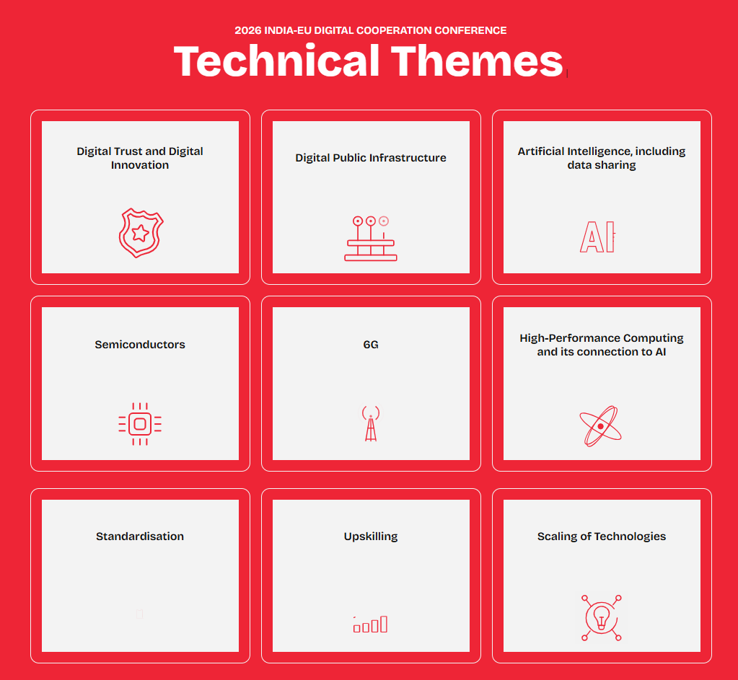
India-EU Digital Cooperation Conference
The India-EU Digital Cooperation Conference 2026 will bring together policymakers, researchers, innovators, and business leaders to discuss and advance the cooperation between India and the European Union in the field of digital technologies and their application.
November 2-3, 2026
South Asian University, New Delhi, India
Forum to trigger concrete collaborations
Public Plenary session on Monday Nov. 2, 14.00 - 17.00:
Digital Innovation and Trust: Balancing Security, Regulation and Growth in the EU and India
Learn more and register:
https://inpacehub.eu/eu-india-event-2026/

Slide 20
Final Event: Future of Digital Partnerships with the Indo-Pacific
Join us for the opportunity to:
Learn about INPACE results, legacy, and what comes next?
Discuss with key stakeholders on shared international digital priorities.
Get together with key Digital Partnership actors across regions and technology domains.
Identify future collaboration opportunities, including policy alignment, joint initiatives, and sustainable funding pathways beyond the project’s lifetime.
The event will take place on 20-21 May 2027 in Residence Palace, Brussels.

Slide 21
Pilot projects
Actions which are seeds for following interactions and projects
7 done / on-going / under preparation:
➲
✓
Cross-domain data exchange PlugTest (2025)
​ Digital Public Infrastructure Interoperability Hackathon (2025)
DPI interoperability hackathon (Tokyo 2026)
​ AI-Ready data Challenge (Seoul 2026)
Disruptive semiconductor technologies testbed
NICT/ESA project on 6G in non terrestrial networks

AI Training testbed enrichment
©INPACE 2024-2027

Slide 22
Getting involved in pilot projects
Value your activities / expertises into our forthcoming activities
  Quality metrics for AI Ready data
  AI models training improvement over EU / IndoPacific region
  Trusted data exhange
  Waiting for your ideas/proposals as long as they fit DP and TTC priorities

Slide 23



Keep in touch with us!
@INPACEHub
info@inpacehub.eu
@INPACE_Hub
www.inpacehub.eu
@INPACE
Join the INPACE Hub!
https://egcp.enrich-global.eu/communities/inpace
©INPACE 2024-2027
23

Slide 24




Thank you
The INPACE project has received funding from the European Union’s Horizon Europe Research and Innovation Programme under grant agreement 101135568. Funded by the European Union (INPACE, 101135568). Views and opinions expressed are however those of the author(s) only and do not necessarily reflect those of the European Union. Neither the European Union nor the granting authority can be held responsible for them. This work has received funding from the Swiss State Secretariat for Education, Research and Innovation (SERI).

Slide 25
Q&A Session

